Slide 1
Table of Contents
Motivation and Objectives
Design Approach
Major Components
Control Module Flow Chart
Sensing Module Flow Chart
Video Module Flow Chart
User Interface Results
Technical Difficulties
Future Work

Slide 2
Motivation and Objectives
Motivation:
Enhance human safety
Portable device
Objectives:
Remote control from at least 100 ft
Live video with a minimum resolution of 480p
Air quality sensing with a temperature accuracy of ± 2° F

Slide 3
Design Approach
Three main modules:
Control
Remote control of the robot
Sensing
Collect air quality data
Display of data
Data analysis
Video
Live streaming
Facial detection
Screenshots

Slide 4
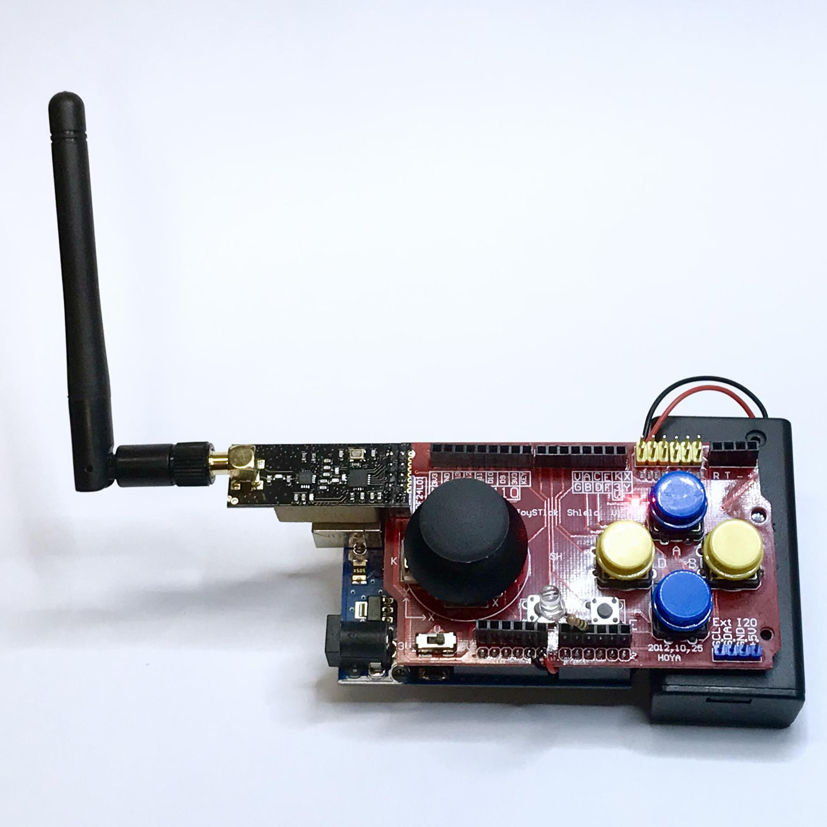
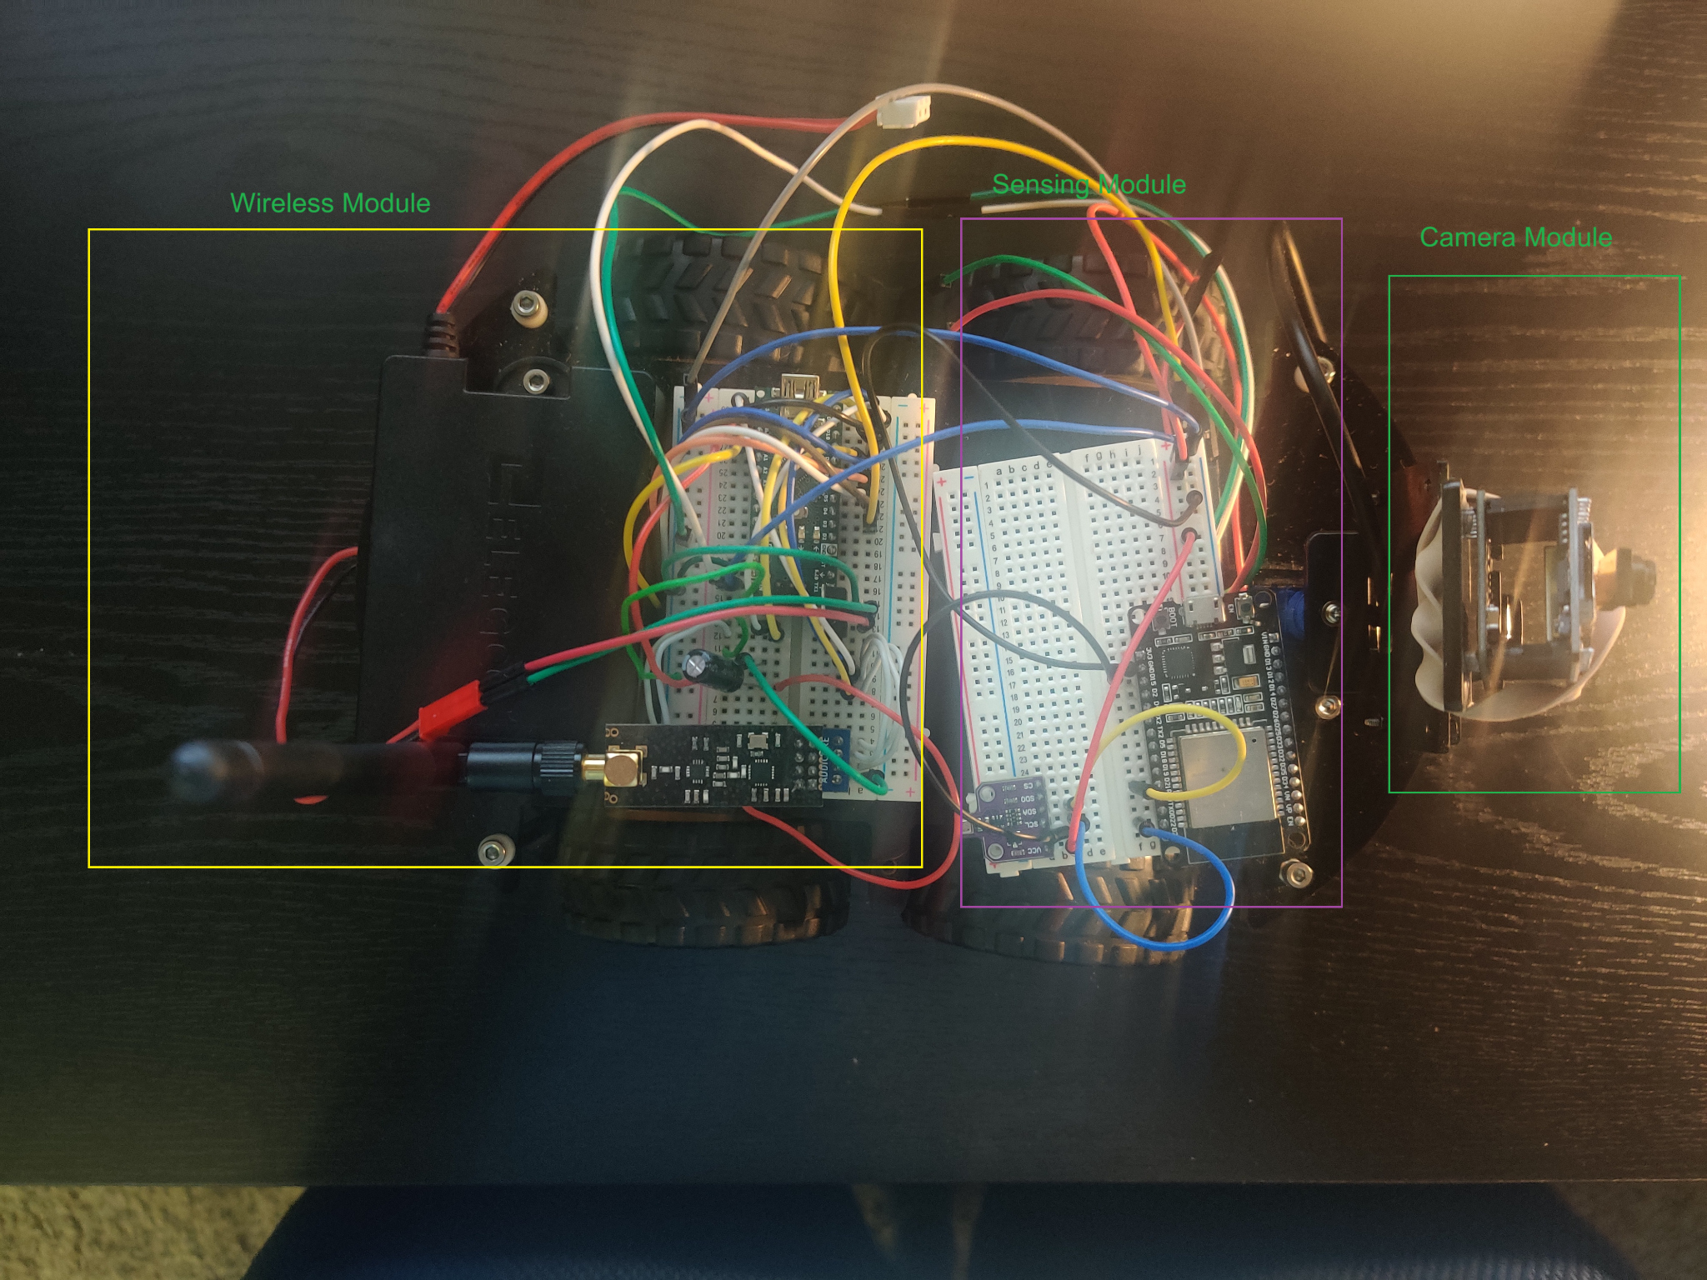
Major Components
Controller - Transmitter (Tx)
Robot - Receiver (Rx)

Slide 5
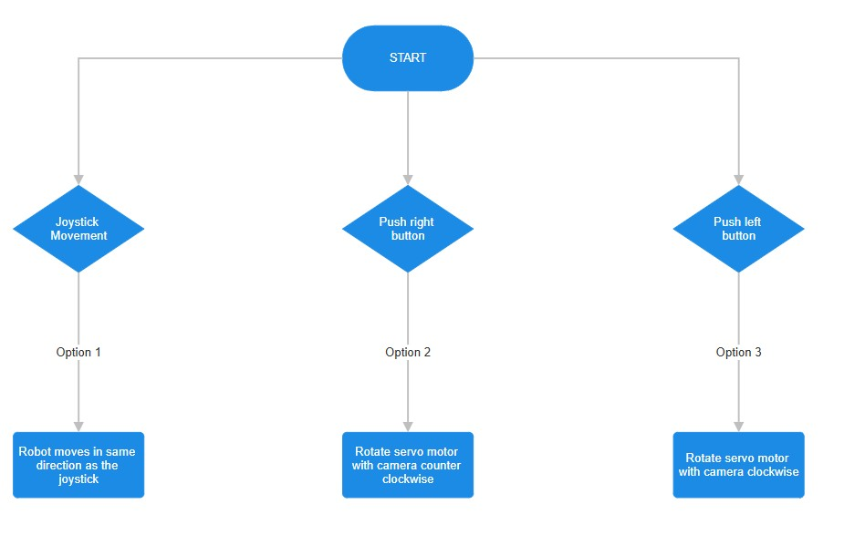
Control Module Flow Chart

Slide 6
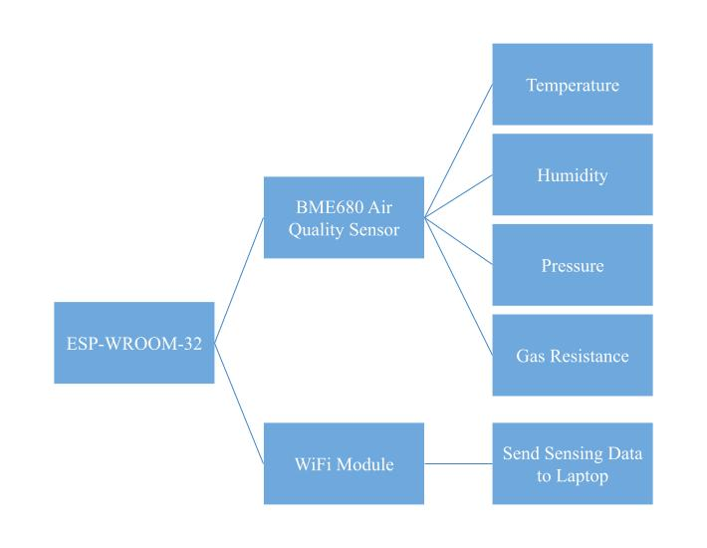
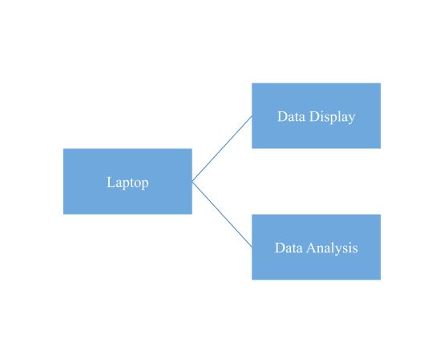
Sensing Module Flow Chart

Slide 7
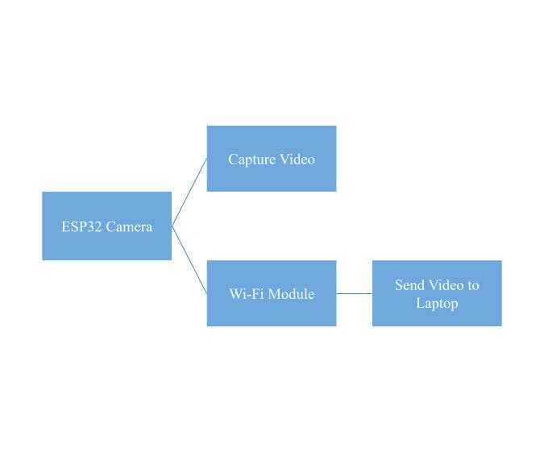
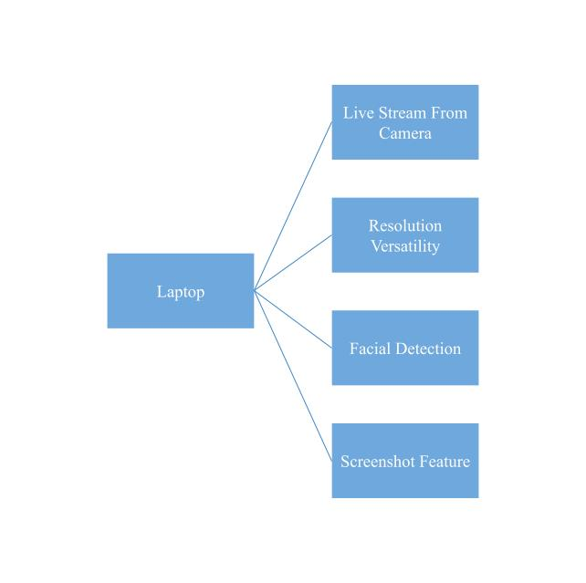
Video Module Flow Chart

Slide 8
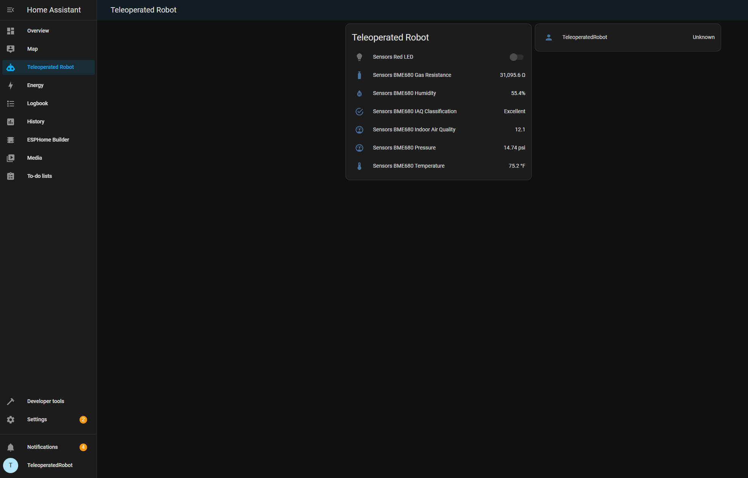
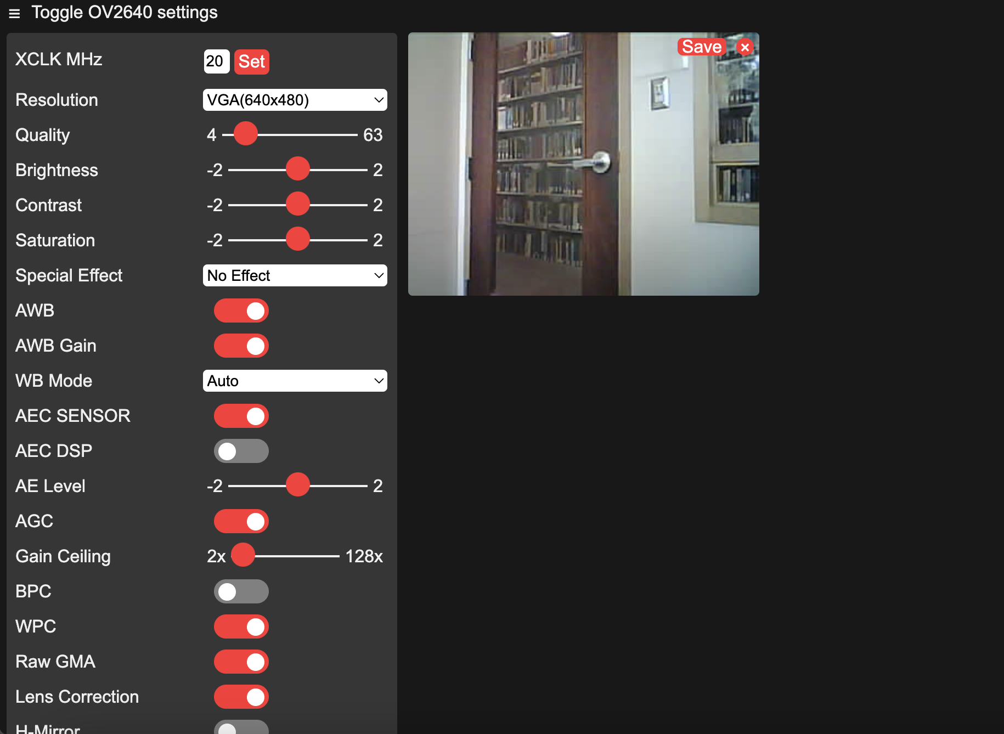
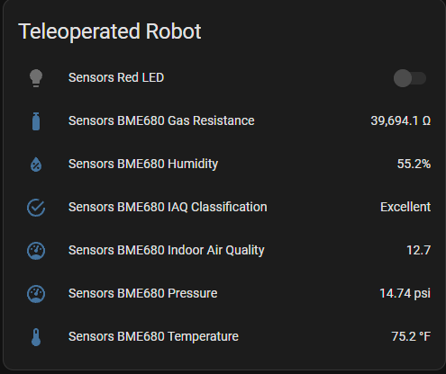
User Interface Results
ESPHome dashboard
Video dashboard

Slide 9
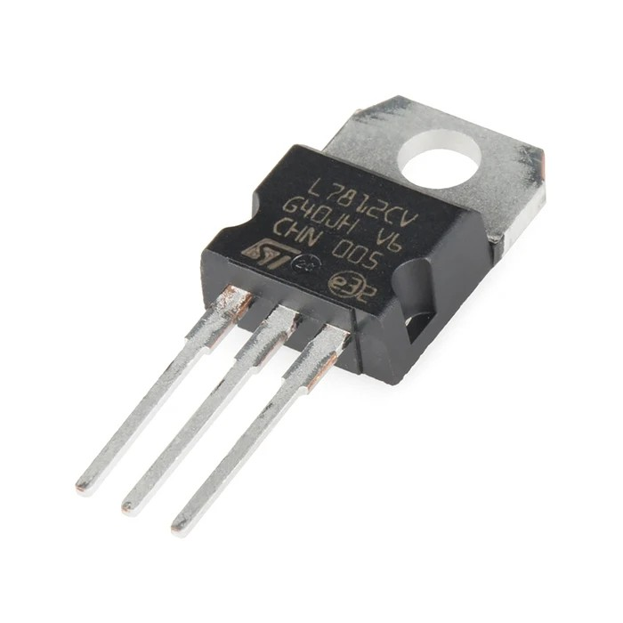
Technical Difficulties
Issues
Solutions
Servo motor rotation
Wireless Communication Signal
Dedicated Power Supply
Capacitor and Battery

Slide 10
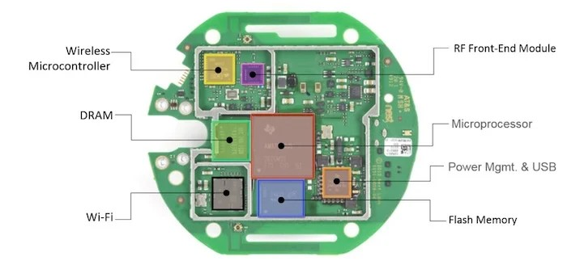
Future Work
Design chassis using a 3D Printer
Design our own Printed Circuit Board (PCB)

